Slide 1
Project 2: Job Fraudulence
Sam Mathieu, Shyla Sharma, and Ruben Valdovinos

Slide 2
Problem Statement
Explore if missing data from job descriptions has an effect on job fraudulence
Explore what features impact job fraudulence
Explore the length of textual data
Make a model to see what aspects of job descriptions serve as the best predictors for fraudulence
Notes:
Sam

Slide 3
About the Data
Is from Kaggle
Contains job descriptions from 18,000 job postings
800 of the 18,000 are fraudulent
Most of the information in the dataset is textual
Factors we used include: salary, fraudulence, employment type, industry, education and experience level, company profile, benefits, etc…
Notes:
Sam

Slide 4
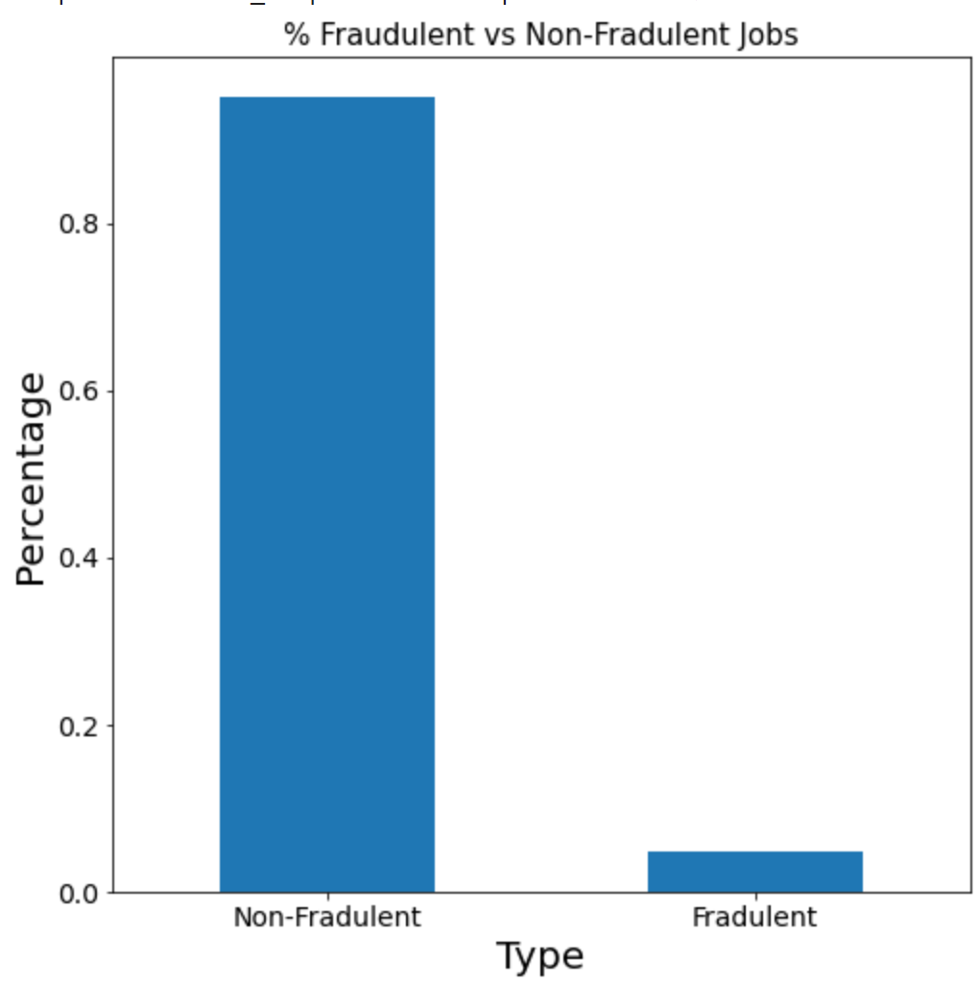
So how many jobs are fraudulent…?
Non-Fraudulent ~ 95%
Fraudulent ~ 5%
Notes:
Sam

Slide 5
Missing Data….
Notes:
Sam

Slide 6
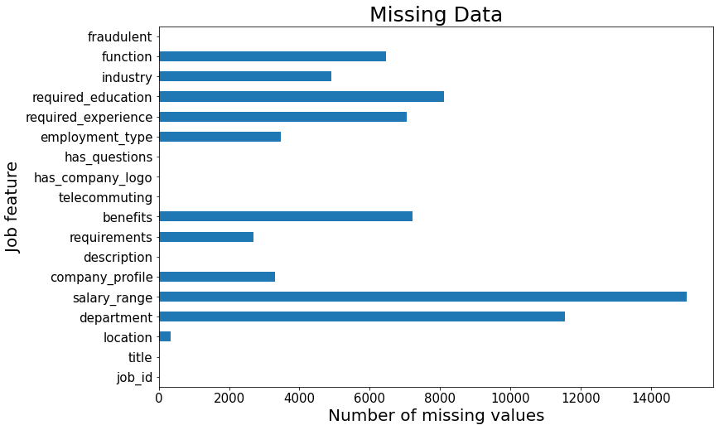
Notes:
Sam

Slide 7
Missing Values Model
Missing Values:
Salary range and department had most NA values
Job postings lacking certain descriptions and features may be a good indicator of fraudulence
True Positive Rate 0.83 | False Positive Rate 0.17
False Negative Rate 0.36 | True Negative Rate 0.64
Accuracy: 0.83
ROC AUC: 0.75
Notes:
Sam

Slide 8
Features
Notes:
Shyla

Slide 9
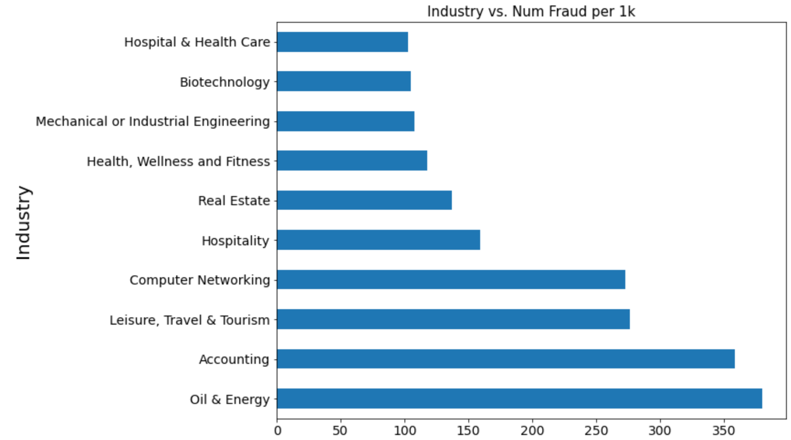
Which industries have the most fraud…?
Oil & Industry ~ 380 per 1K
Accounting ~ 358 per 1K
…
9) Biotechnology ~ 105 per 1K
10) Hospital & Health Care ~ 102 per 1K
Notes:
Shyla

Slide 10
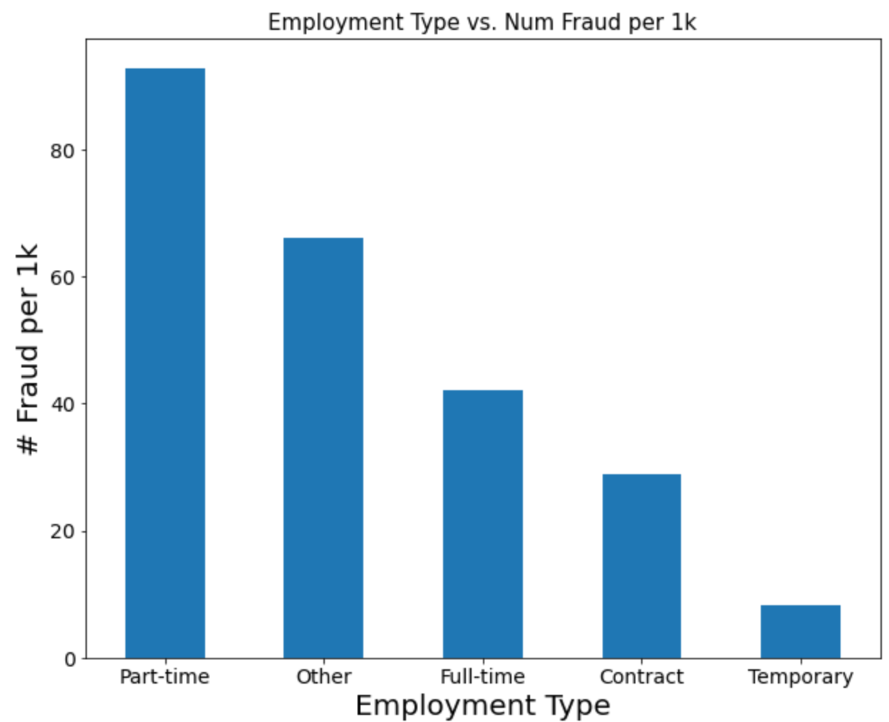
What about Employment Type…?
Part Time ~ 92 Jobs per 1K
Other ~ 66 Jobs per 1K
Full Time ~ 42 Jobs per 1K
Notes:
Shyla

Slide 11
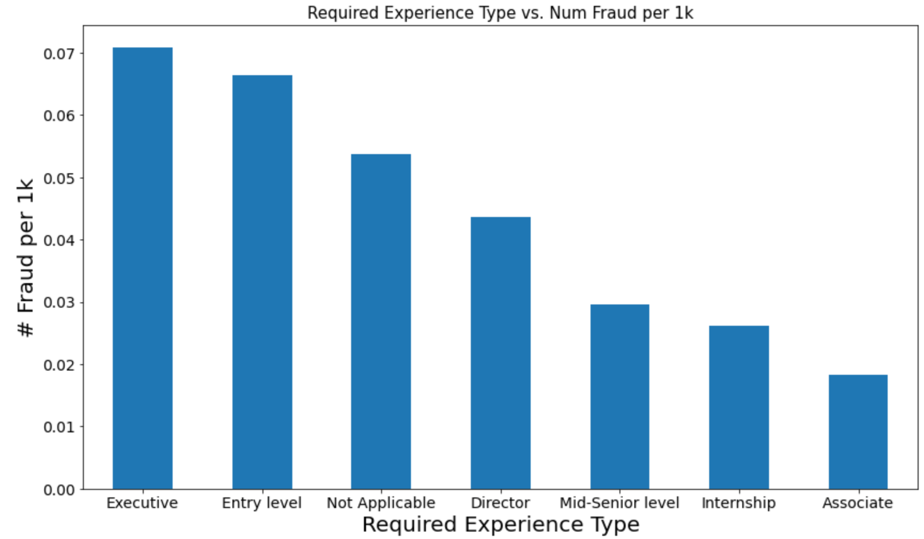
And Required Experience…?
Executive ~ 70 per 1K
Entry Level ~ 66 per 1K
…
7) Associate - 18 per 1K
Notes:
Shyla

Slide 12
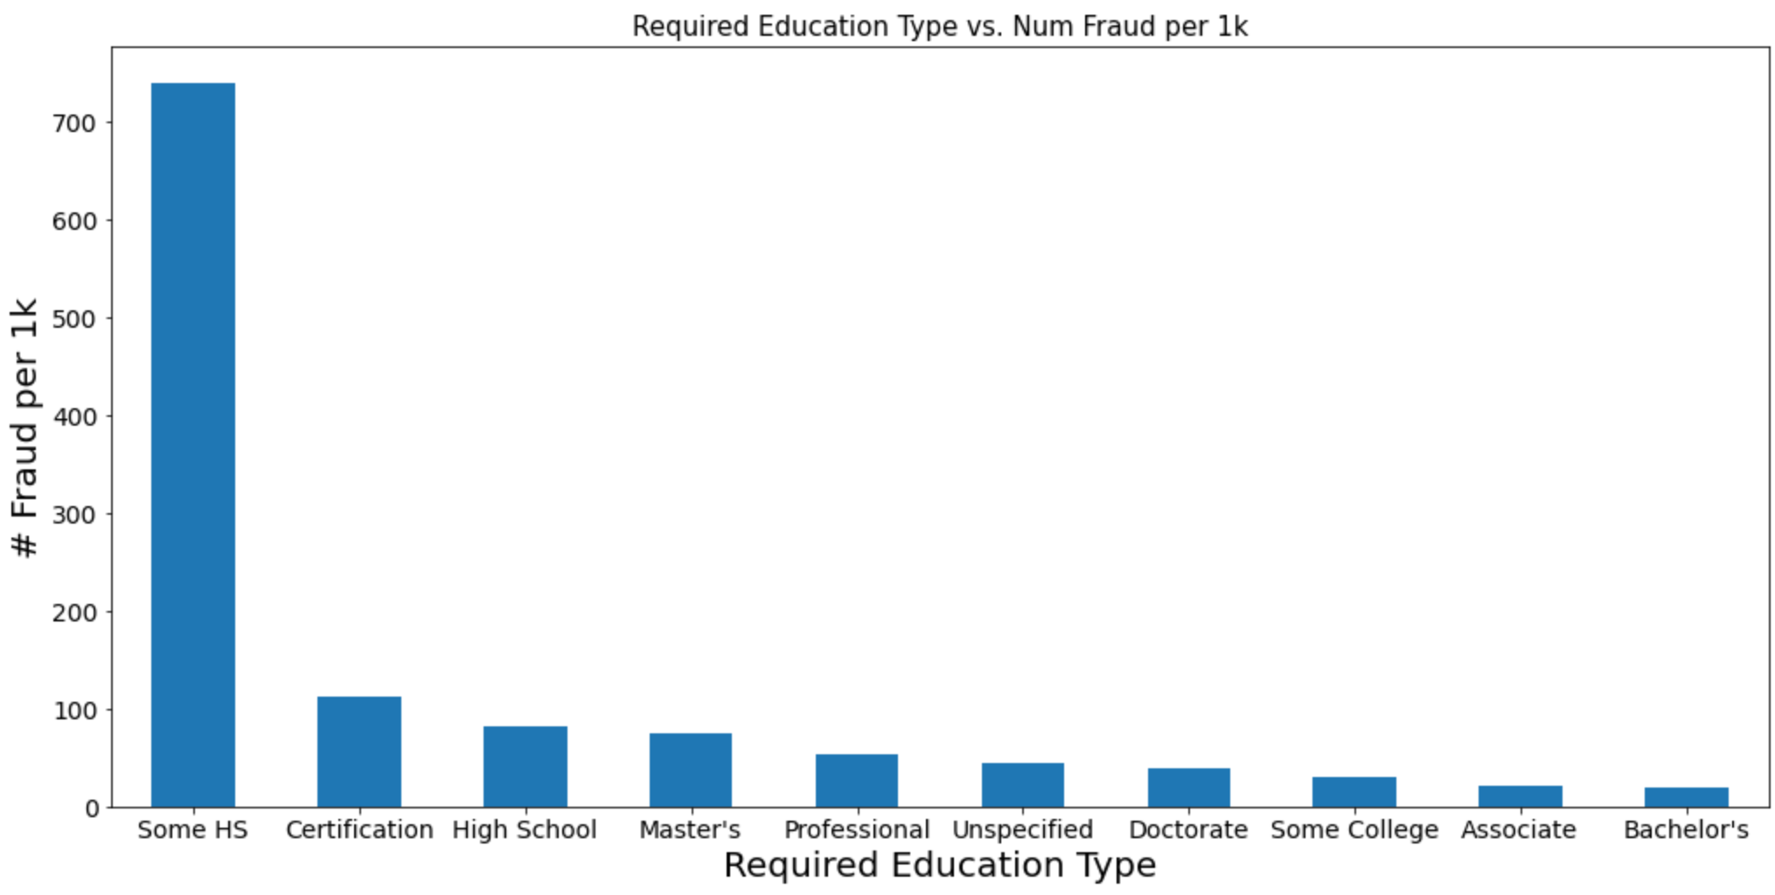
Required Education…?
Some HS ~ 740 per 1K
Certification ~ 111 per 1K
High School ~ 81 per 1K
…
10) Bachelor’s ~ 18 per 1K
Notes:
Shyla

Slide 13
Features Model
Features:
Top 10 Industries with the most fraudulence
Part-Time Employment
Executive and Entry Level Required Experience
Some High School Education
True Positive Rate 0.89 | False Positive Rate 0.11
False Negative Rate 0.51 | True Negative Rate 0.48
Accuracy: 0.89
ROC AUC: 0.69
Notes:
Shyla

Slide 14
Textual Data
Notes:
Ruben

Slide 15
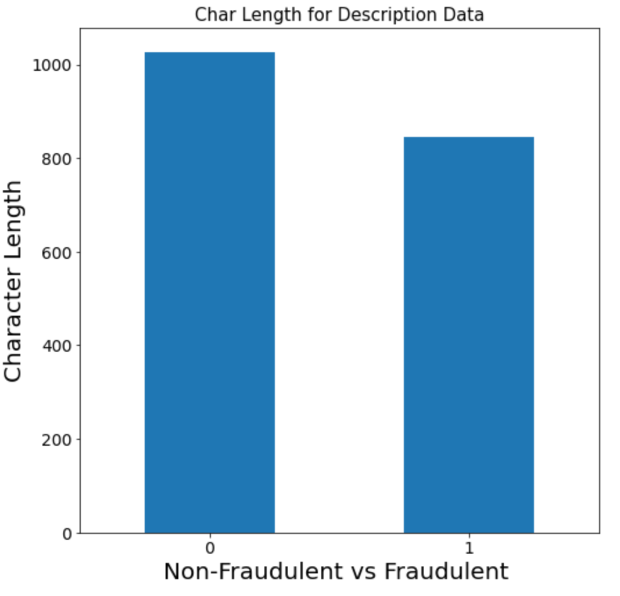
A closer look at the Description Data…
Non-Fraudulent ~ 47 Characters
Fraudulent ~ 36 Characters
Notes:
Ruben

Slide 16
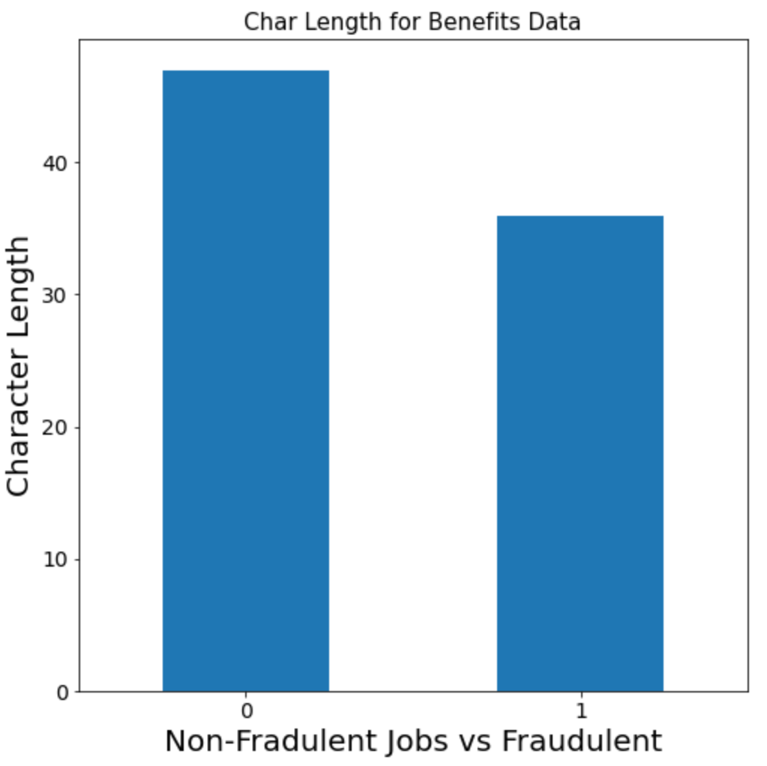
Benefits Data…
Non-Fraudulent ~ 1027 Characters
Fraudulent ~ 844 Characters
Notes:
Ruben

Slide 17
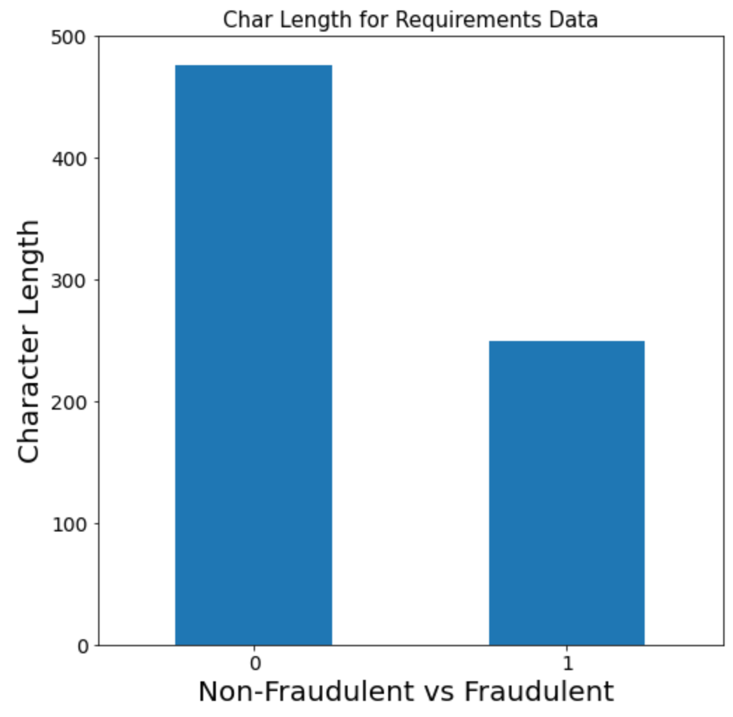
Requirements Data…
Non-Fraudulent ~ 476 Characters
Fraudulent ~ 249 Characters
Notes:
Ruben

Slide 18
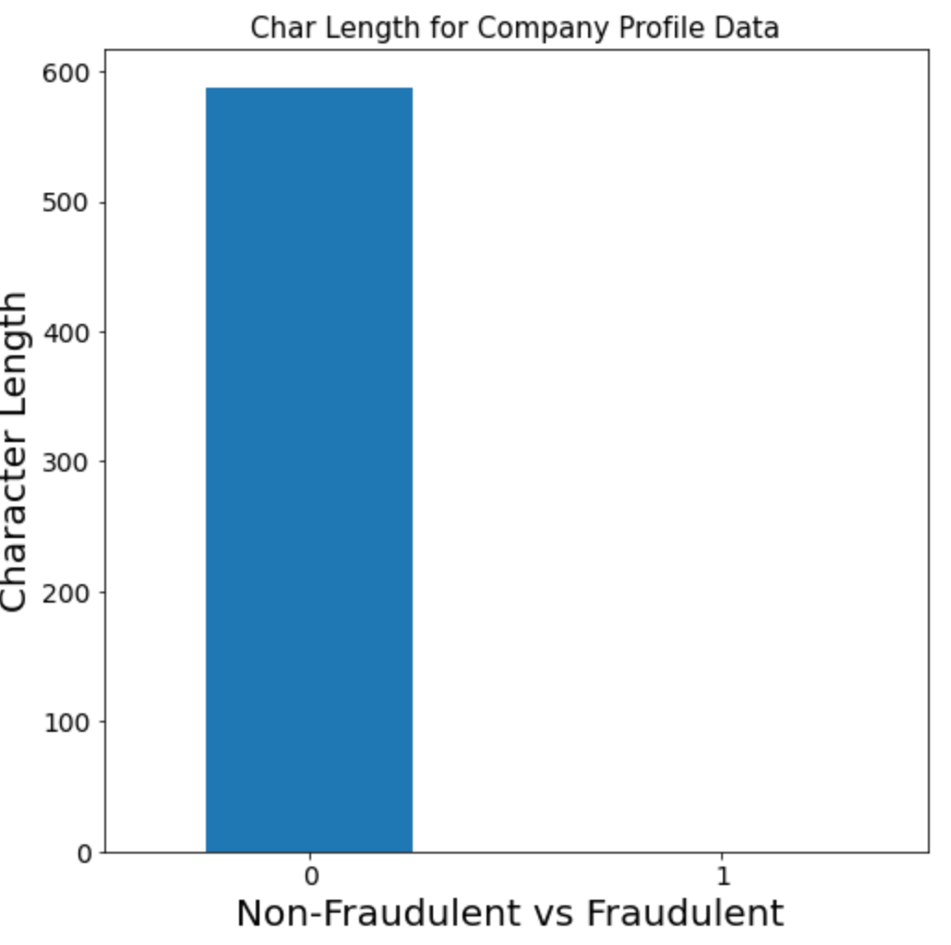
Company Profile Data…
Non-Fraudulent ~ 588 Characters
Fraudulent ~ 0 Characters
Notes:
Ruben

Slide 19
Character Length Model
Features:
Out of the four we found that company profile was the most important in the model
True Positive Rate 0.62 | False Positive Rate 0.37
False Negative Rate 0.27 | True Negative Rate 0.73
Accuracy: 0.62
ROC AUC: 0.68
Notes:
Ruben

Slide 20
Combined Model
Notes:
Shyla

Slide 21
Combined Model
Features: :
Uses all columns we have previously mentioned
Missing Values Data
Features
Character Length
Has the best overall results
True Positive Rate 0.79 | False Positive Rate 0.21
False Negative Rate 0.17 | True Negative Rate 0.83
Accuracy: 0.79
ROC AUC: 0.80
Notes:
Shyla

Slide 22
Conclusion
Model was decent with number of missing values from each column predicting fraudulence but could be improved with the addition of other factors
Most notable features included part-time employment, executive or entry level required experience, some high school education, and certain industries
Character length showed that company profile was the most important textual feature followed by requirements
Combined model utilizing all of the factors above had an accuracy of 0.79 and an ROC AUC value of 0.80
Notes:
Ruben

Slide 23
Thank You!
Notes:
Ruben

Slide 24
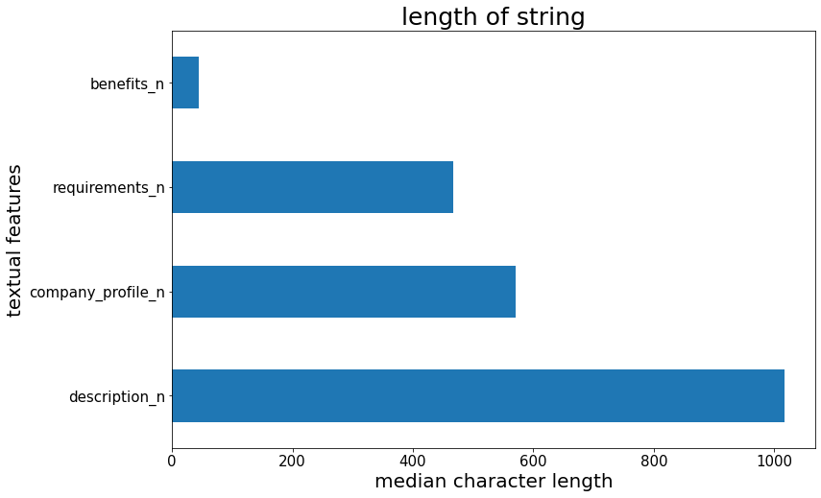
Average length of textual features

Slide 25
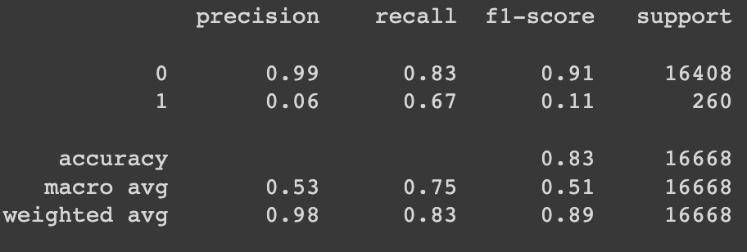
Just NA values

Slide 26
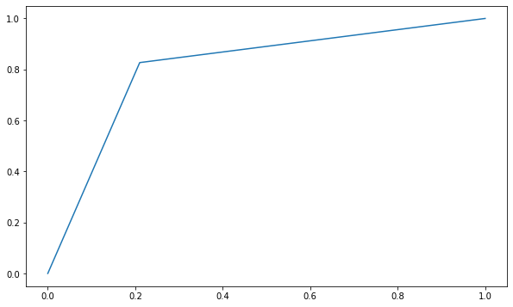
AUROC for combination model

Slide 27
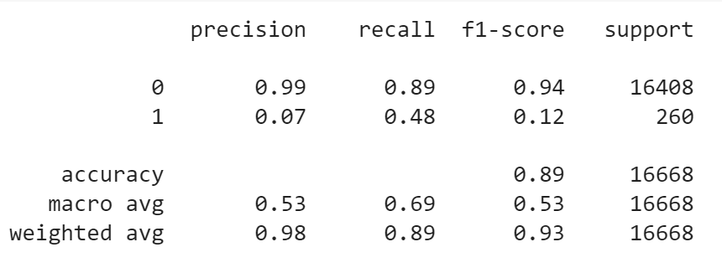
Classification Report for Features Model

Slide 28
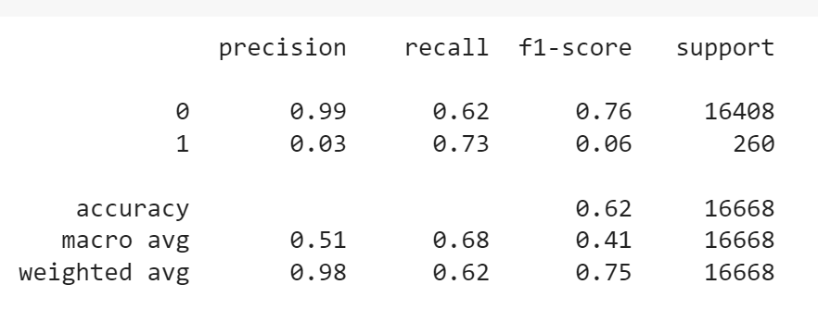
Classification Report for Char Length Model

Slide 29
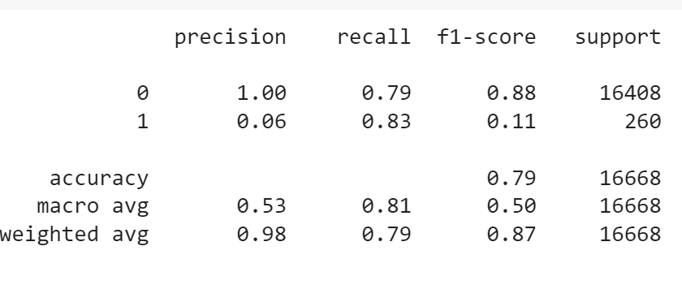
Classification Report for Combined Model

